Slide 1
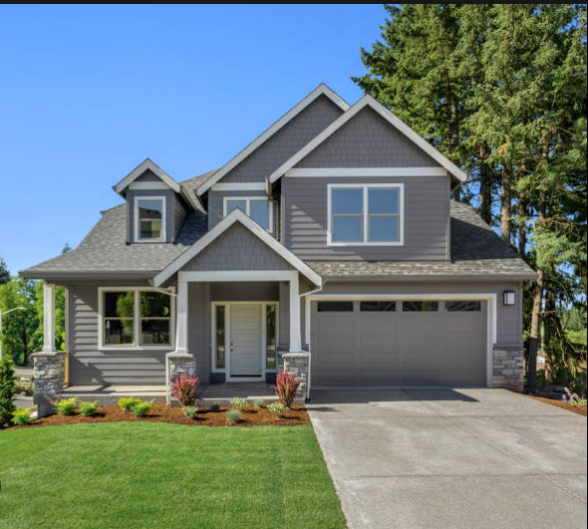



House Price Prediction
Presented By : Hemant Shinde
Github Link:https : //github.com/HEMANT2008
Linkedin : www.linkedin.com/in/hemant- shinde-362490252
Gmail : shindehemant208@gmail.com

Slide 2



Introduction
In This Project , We Have Built A Machine Learning Model To Predict The House Prices Of European City.
This Project Will Very Helpful For The Real Estate Market.
Our Model Can Be Used By Both House Sellers And House Buyers.
Multiple Linear Regression Algorithm Is Used To Create A Model With A Great Accuracy Score.

Slide 3
Agenda
Business Problem
Data collection
Tools Setup for Project
Load Data
Data Pre-Processing
Make Data Ready For Training
ML Model Selection
Model Training
ML Model Testing
Present Solution

Slide 4

Problem Statement
House price prediction can help the developer determine the selling price of a house and can help the customer to arrange the right time to purchase a house.
Predict the price of a house by its features. If you are a buyer or seller of the house but you don't know the exact price of the house, so supervised machine learning regression algorithms can help you to predict the price of the house just providing features of the target house

Slide 5
Data Collection
Data Collection Is the Process Of Gathering and Measuring Data on variable of Interest In An Established Systematic Fashion That Enable One to Answer Stated research Questions , Test Hypotheses , and Evaluate outcomes

Slide 6
Understanding the Basic Data
Data has total 2920 Rows And 81 Columns .
In the Data 19 columns present Null values or Duplicated values.

Slide 7
Exploratory Data Analysis [ EDA]
Understanding the Basic Data
Statistical Data Analysis
Data Visualization

Slide 8
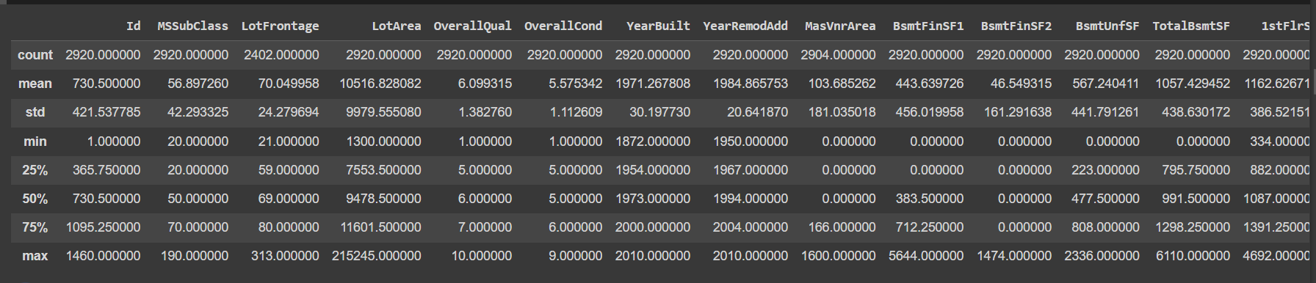
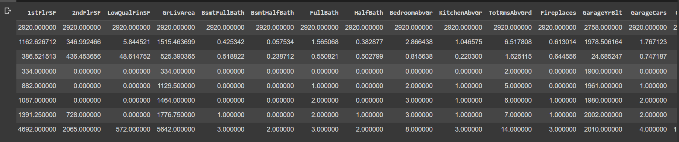
Statistical Data Analysis

Slide 9
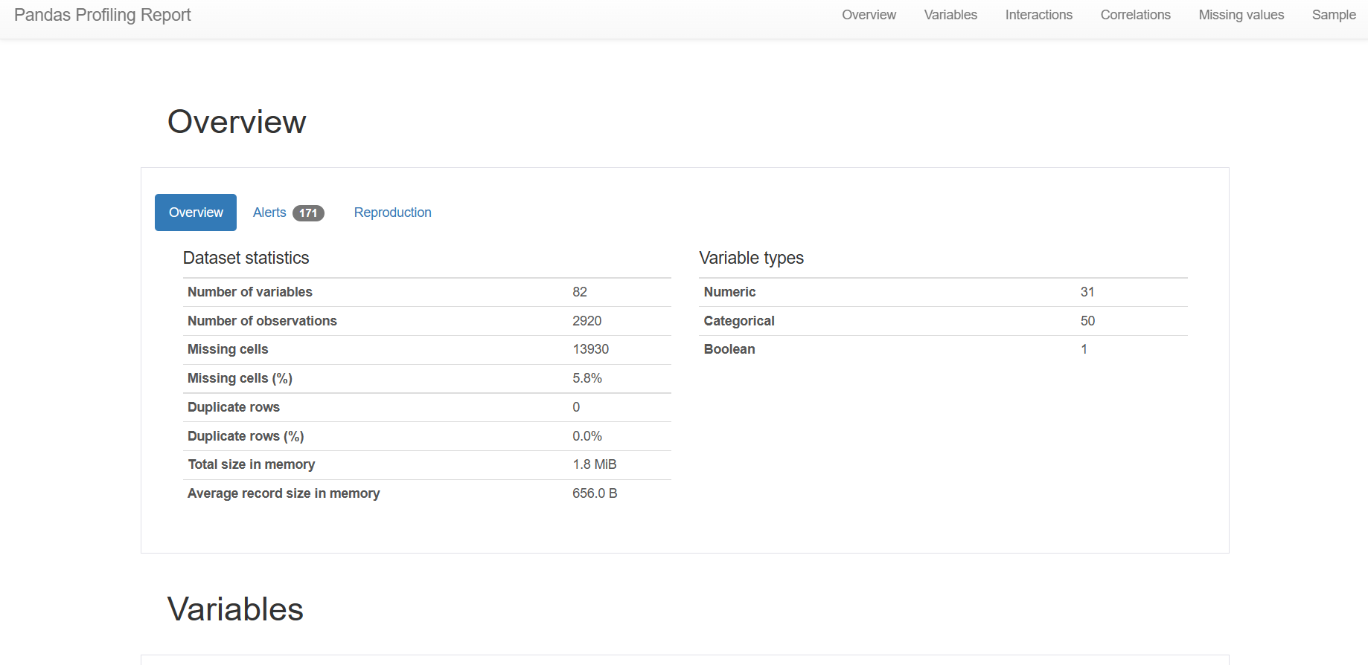

Slide 10
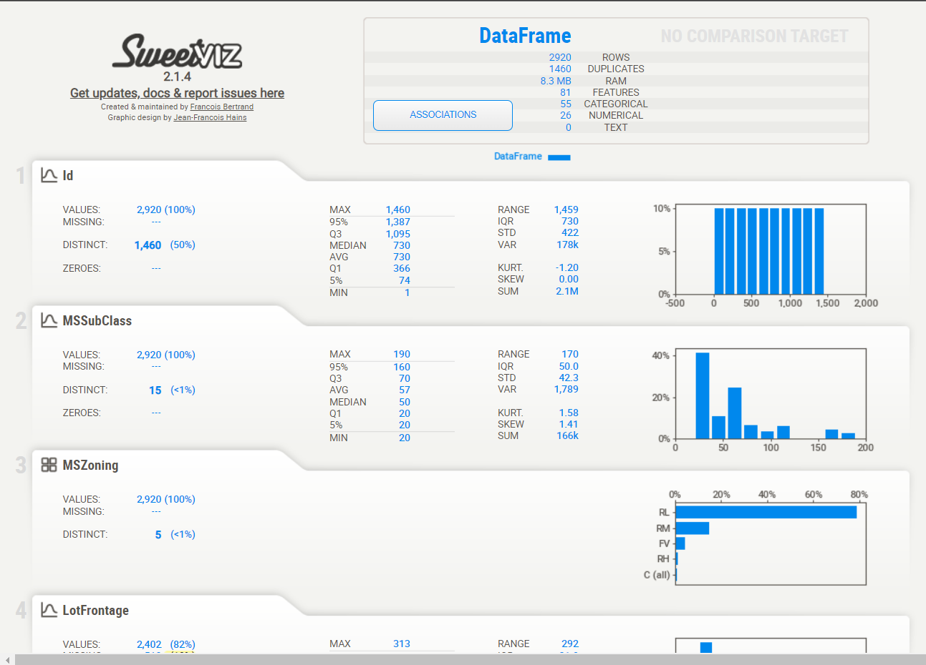
SweetViz Sweetviz is an open-source Python library that helps generate beautiful, highly detailed visualizations to Exploratory Data Analysis with a single line of code. It also generates a summarised report and can help create interactive dashboards as well

Slide 11
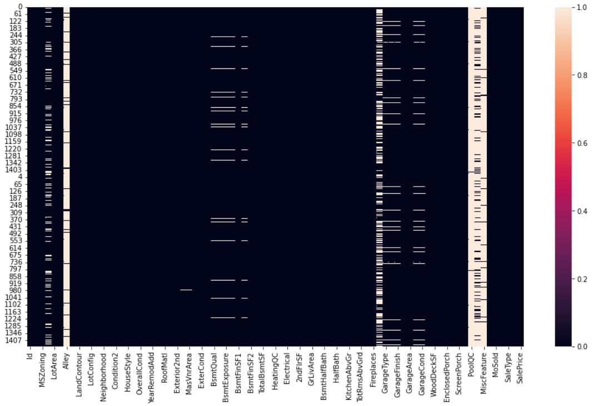
Visualization HeatMap
Heatmap is defined as a graphical representation of data using colors to visualize the value of the matrix

Slide 12

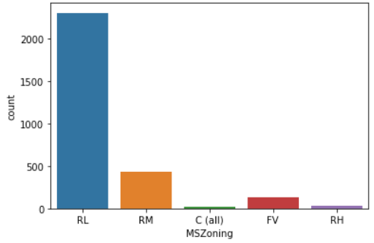
Count Plot
seaborn.countplot() method is used to Show the counts of observations in each categorical bin using bars.

Slide 13
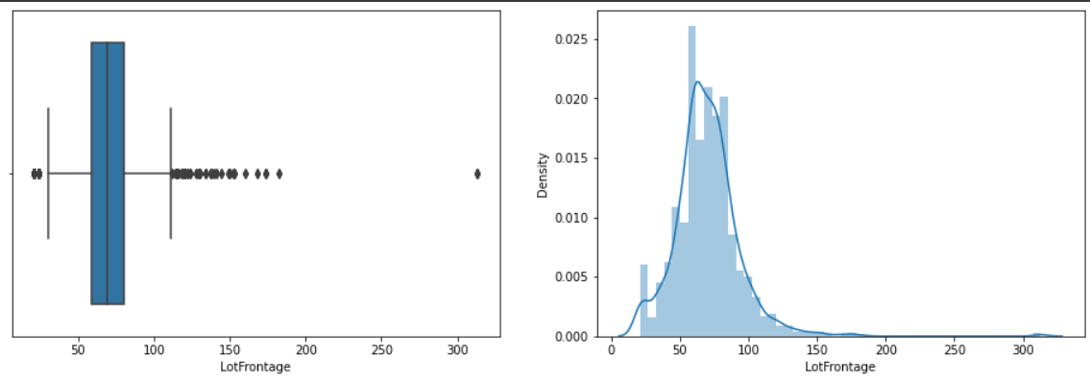
BoxHist Plot A box plot is a method for graphically depicting groups of numerical data through their quartiles.

Slide 14
Feature Transformation
What is Feature Transformation? Feature transformation is a mathematical transformation in which we apply a mathematical formula to a particular column (feature) and transform the values, which are useful for our further analysis. It is a technique by which we can boost our model performance.

Slide 15
Convert Numerical Feature to Categorical Feature

Slide 16
Convert Categorical Feature into Numerical Feature
Machine learning models require all input and output variables to be numeric.
This means that if your data contains categorical data, you must encode it to numbers before you can fit and evaluate a model.
The two most popular techniques are an Ordinal Encoding and a One-Hot Encoding

Slide 17
One Hot Encoding

Slide 18
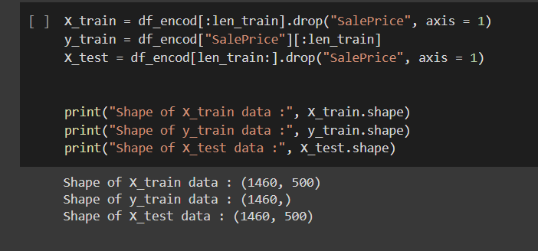
Split Data For Training and Testing

Slide 19
Model Selection

Slide 20
Deployment

Slide 22
Challenge

Slide 23
Thank You

